Slide 1
ASSIGNMENT-
DENCO CORP CUSTOMER PART SALES.
PAWAR BHARATH

Slide 2
WHO ARE THE MOST LOYALCUSTOMERS ?
LOYAL CUSTOMERS WITH RESPECT TO BUYING MORE PARTS !
CUSTNAME REGION NO.OF PARTS
CHIZ BROS INC 02-Central 236
ARMIL / C F S INC 02-Central 174
ZAR-TECH 01-East 162
FIBRECAST INC. 07-Canada Direct 158
REFRACTORY ENGINEERS 02-Central 142
INC.

Slide 3
LOYAL CUSTOMERS WITH RESPECT TO MAKING MORE MARGIN !
CUSTOMER NAME MARGIN
TRIUMPH INSULATION 12971524.63
CORNING SHARED SERVICES 10766305.54
THERMAL PRODUCTS INC 4449739.59
INDUSTRIAL FURNACE CO 3561703.00
DELTA REFRACTORIES 3402966.02

Slide 4
LOYAL CUSTOMERS WITH RESPECT TO GENEARATING MORE
REVENUE !
CUSTNAME REGION REVENUE
TRIUMPH INSULATION 01-East 35592531.24
CORNING SHARED SERVICES 01-East 12843518.78
THERMAL PRODUCTS INC 02-Central 7209418.18
WESTERN INDUSTRIAL CERAMI 01-East 5562611.79
INDUSTRIAL FURNACE CO 01-East 5527151.10

Slide 5
Which customers contribute the most to their revenue?
CUSTNAME REGION REVENUE
TRIUMPH INSULATION 01-East 35592531.24
CORNING SHARED SERVICES 01-East 12843518.78
THERMAL PRODUCTS INC 02-Central 7209418.18
WESTERN INDUSTRIAL CERAMI 01-East 5562611.79
INDUSTRIAL FURNACE CO 01-East 5527151.10

Slide 6
What part numbers bring in to significant portion of revenue?
PARTNUM REVENUE
733648000 30075436.38
735602000 16151536.25
734370000 12641200.00
764821000 6481616.55
726000062 6309275.85

Slide 7
What parts have the highest profit margin?
PARTNUM MARGIN
733648000 11003367.44
734370000 10627732.81
735602000 10543453.82
764821000 4022430.49
764901000 2419071.63

Slide 8
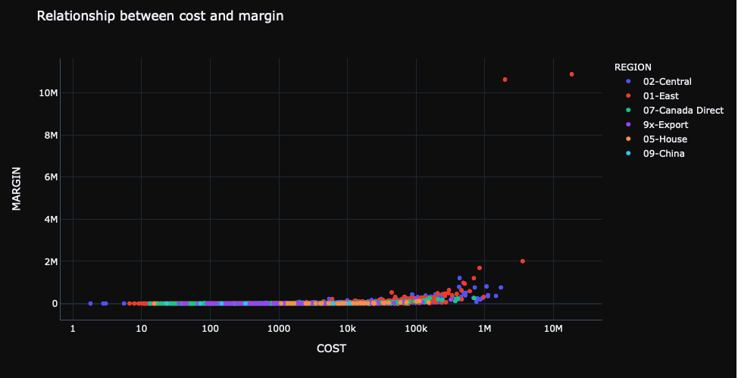
BI-VARIATE ANALYSIS FOR COST AND MARGIN ?
The range till cost and margin are having relationship is manufacturing cost(3m) margin generated (2m).
The higher margin generated for lower cost is in the region of 01-east i.e, for
2m-cost margin is 10m.

Slide 9
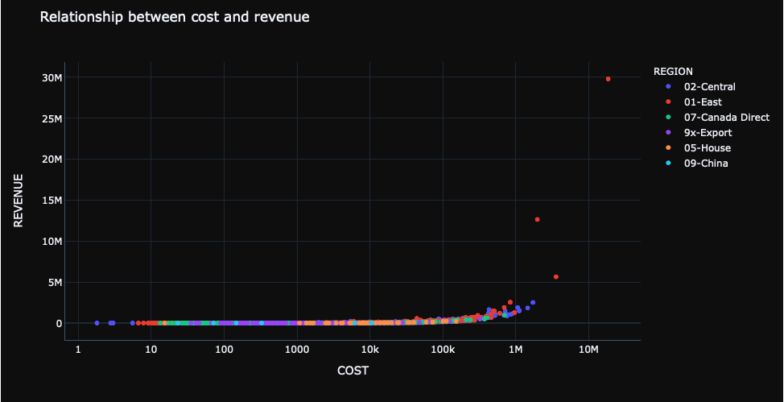
BI-VARIATE ANALYSIS FOR COST AND REVENUE ?
The range till which cost and revenue are having relationship is cost(0-5m) -revenue(0-5m).
The higher revenue is in 01-east region i.e, manufacturing cost is 2m and revenue is 12m.
manufacturing cost is 3m and revenue is 5m.
manufacturing cost is18m and revenue is 29m.

Slide 10
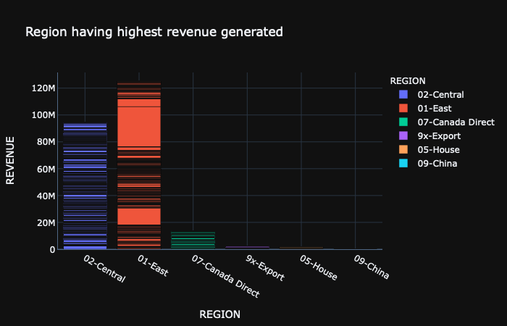
WHICH REGION HAVING HIGHEST REVENUE GENERATED ?
01-EAST HAVING HIGHEST REVENUE GENERATED .

Slide 11
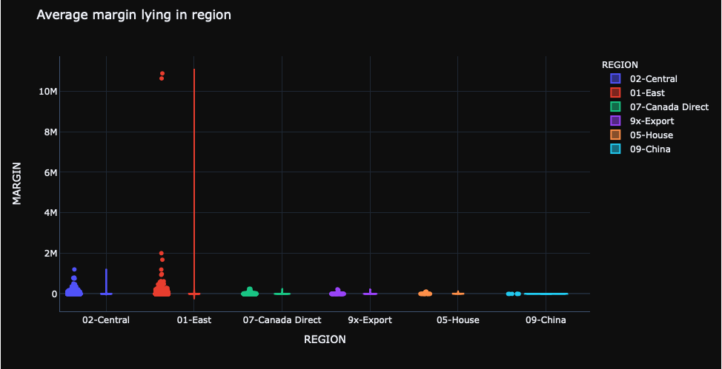
WHAT IS THE AVERAGE RANGE MARGIN WITH RESPECT TO REGION ?
01-east having highest margin .
lower fence = -9,010.49.
upper fence = 17.52402 k.

Slide 12
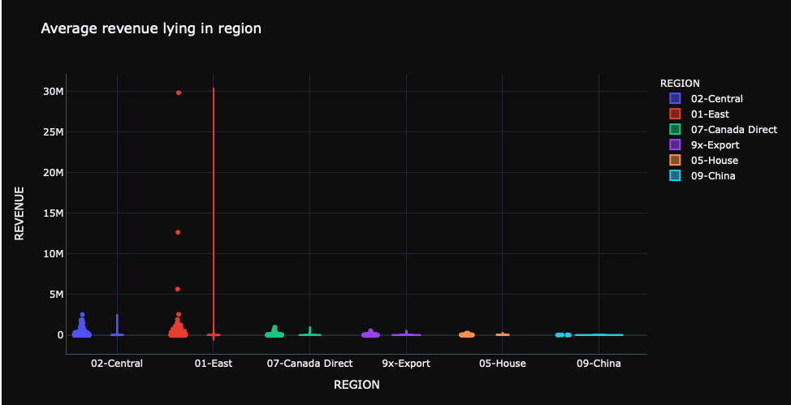
WHAT IS THE AVERAGE RANGE REVENUE WITH RESPECT TO REGION ?
01-east having highest revenue generated.
upper fence=29.220k

Slide 13
FINDINGS
Region 01-east having highest revenue generated and also highest margin generated.
For less cost of manufacturing part the revenue increases only.
There is no-relationship if cost increasing for manufacturing (&) revenue generated .

Slide 14
ASSUMPTIONS
Loyal customers are client company who is making more margin in our corporation,who is buying more parts,and also generating more revenue.
Top 5 customers are the loyal customers,top 5 parts are bringing highest revenue,top 5 parts are bringing highest margin.
Taken range between cost and margin till which they are having relationship.
Taken range between cost and revenue till which they are having relationship.

Slide 15
THANK YOU

